Slide 1
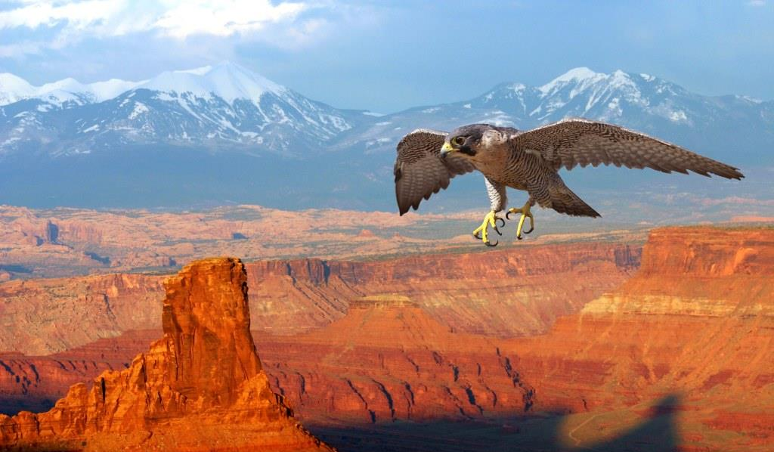
THE VOICE OF FISH & WILDLIFE AGENCIES
The collective voice of state, provincial and territorial fish and wildlife agencies

Slide 2
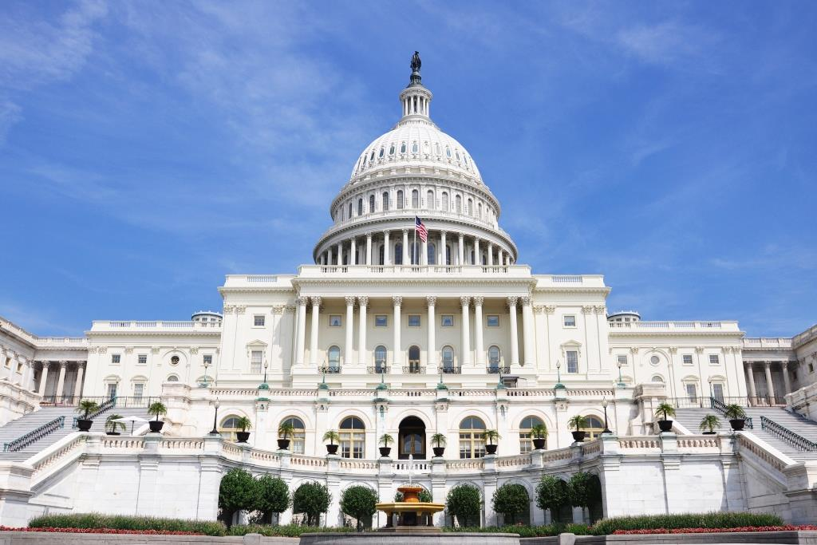
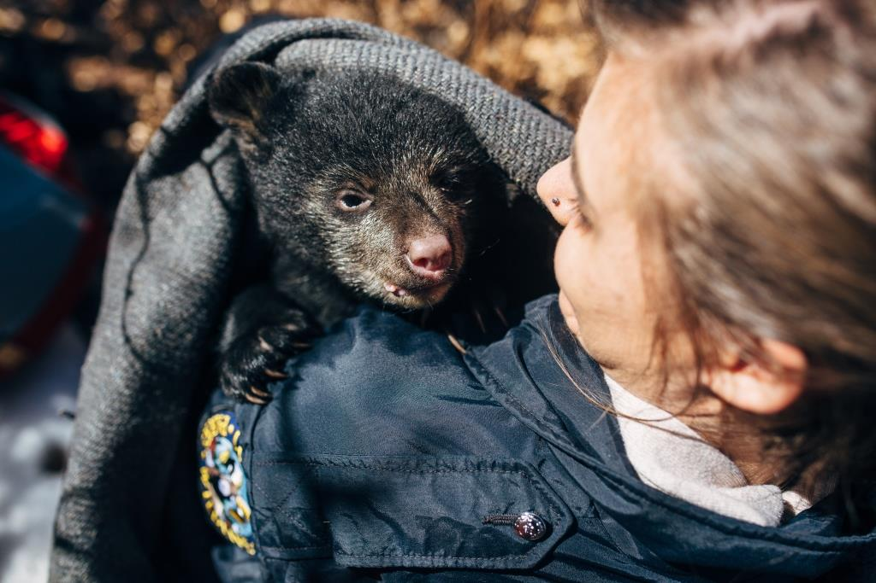
The Association represents member agencies on Capitol Hill and before the Administration on key conservation and management policies to ensure fish and wildlife priorities are addressed and to secure broader, sustained funding for fish and wildlife conservation.
A NATIONAL AGENDA
Notes:
For more than a century, the Association of Fish and Wildlife Agencies has been the collective voice of North America’s fish and wildlife agencies at every level of government.
The Association represents its state agency members on Capitol Hill and before the Administration on key conservation and management policies, and works to ensure that all fish and wildlife entities work collaboratively on the most important issues. The Association also provides management and technical assistance to both new and current fish and wildlife leaders.

Slide 3
To support and advocate for State, Provincial, and Territorial responsibility for science-based fish and wildlife conservation.
Our mission
Notes:
The Mission of the Association of Fish & Wildlife Agencies is to:
Protect and support state, provincial and territorial authority for fish and wildlife conservation
Promote sound resource management; and
Strengthen federal, state, provincial, territorial and private cooperation in conserving fish and wildlife and their habitats in the public interest
To conserve fish and wildlife and their habitats in the public interest

Slide 4
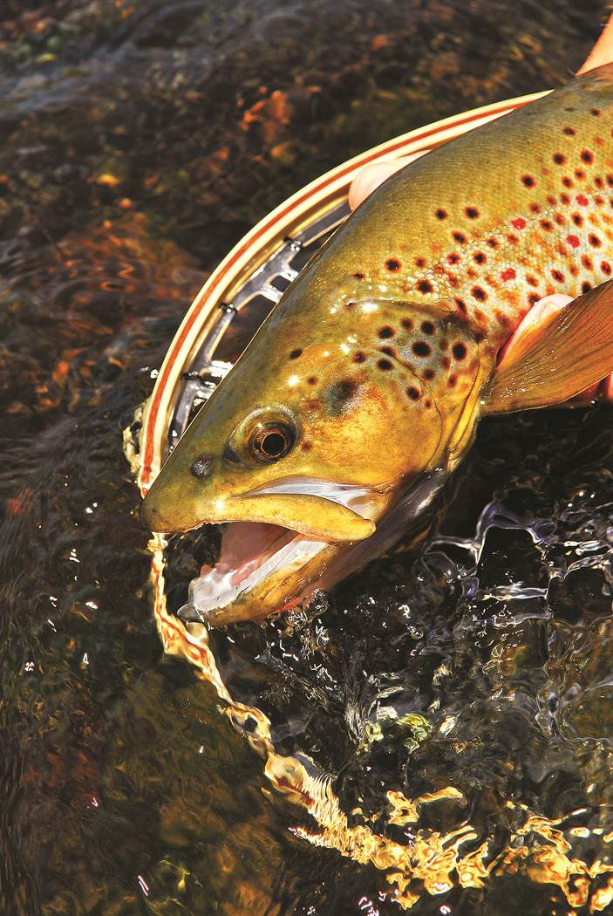
Contribute their expertise on more than 70 committees, subcommittees and working groups….
Agricultural Conservation ▪ Amphibian & Reptile Conservation ▪ Angler/Boating Participation ▪ Annual Meeting/Awards/Nominating ▪ Audit ▪ Bird Conservation ▪ Climate Change ▪ Education, Outreach & Diversity ▪ Energy and Wildlife Policy ▪ Executive ▪ Federal and Tribal Relations ▪ Finance ▪ Fish & Wildlife Health ▪ Fish and Wildlife Trust Fund ▪ Fisheries/Water Resources Policy ▪ Hunting/Shooting Sports Participation ▪ International Relations ▪ Invasive Species ▪ Joint Federal/State Task Force on Federal Assistance Policy ▪ Law Enforcement ▪ Leadership/Professional Development ▪ Legal ▪ Legislative and Federal Budget ▪ National Grant ▪ Ocean Resources Policy ▪ Resolutions ▪ Science and Research ▪ Sustainable Use of Wildlife ▪ Technology & Data ▪ Threatened/ Endangered Species Policy ▪ Wildlife Diversity Conservation and Funding ▪ Wildlife Resource Policy
… and more!

Slide 5
milestones
2018: Supports passage of Farm Bill Re-authorization
2017: Introduction of the Recovering America’s Wildlife
Act; Project WILD joins AFWA
2014: Launch of the Blue Ribbon Panel on Sustaining
America’s Diverse Fish & Wildlife Resources
2012: Supports reauthorization on the Magnuson-
Stevens Act and the Sportfish & Boating Safety
Trust Fund
2009: Establishes Southern Wings
2006: Founds National Conservation Leadership
Institute
2000: Begins Multistate Conservation Grants Program
with USFWS
2000: Successfully advocates for creation of State
Wildlife Grants Program resulting in over
$1 Billion to States

Slide 6
The Association provides member agencies and their staff with coordination services centered on four strategic priorities:
Fish & Wildlife Funding
Policy & Legislative Advocacy
Coordinated Conservation Initiatives
Member Support

Slide 7
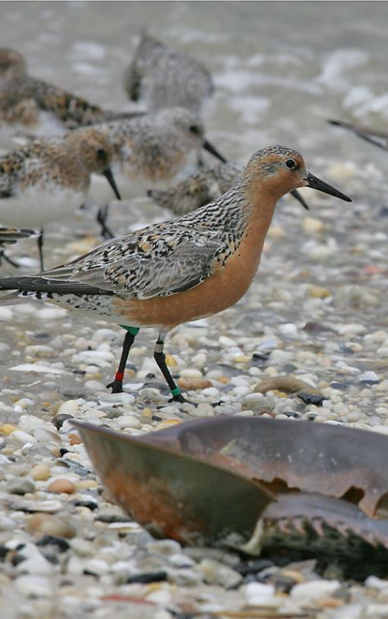
Fish & wildlife funding
Notes:
Goal: secure and sustain comprehensive and dedicated funding for fish and wildlife conservation
Initiatives: protect and enhance trust funds; secure conservation and wildlife associated recreation funding

Slide 8
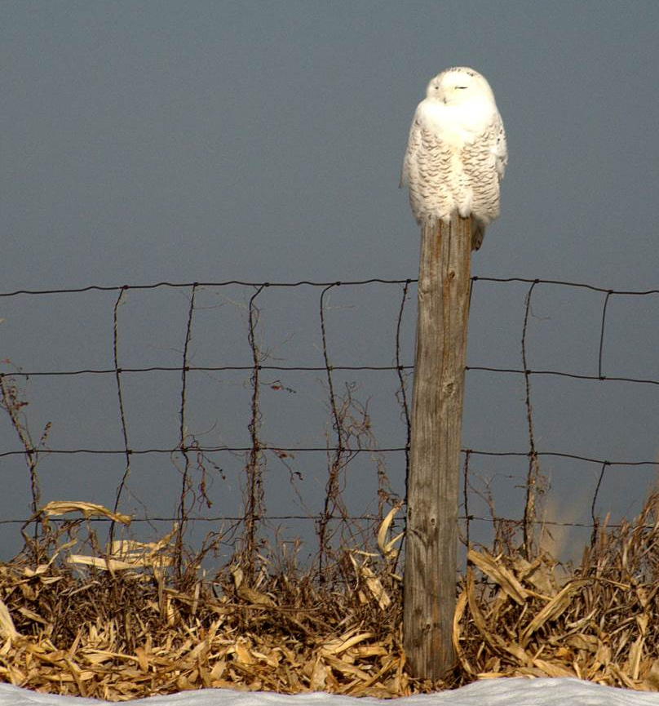
Policy & legislative advocacy
Current Congressional focus:
Appropriations
Recovering America’s Wildlife Act
National Fish Habitat Legislation
Modernization of the P-R Fund for Tomorrow’s Needs Act of 2017
Farm Bill Re-authorization
Sportsmen Conservation Re-authorization
Notes:
Goal: promote policies, legislation, laws, regulations and legal strategies that enhance and protect member agencies’ ability to conserve and manage fish and wildlife resources and their habitats, consistent with the North American Model of Wildlife Conservation
Initiatives: Enhance state authority to manage fish and wildlife; build congressional support for state fish & wildlife agencies; secure authorization/re-authorization of conservation-related legislation; strengthen collaboration with the executive branch

Slide 9
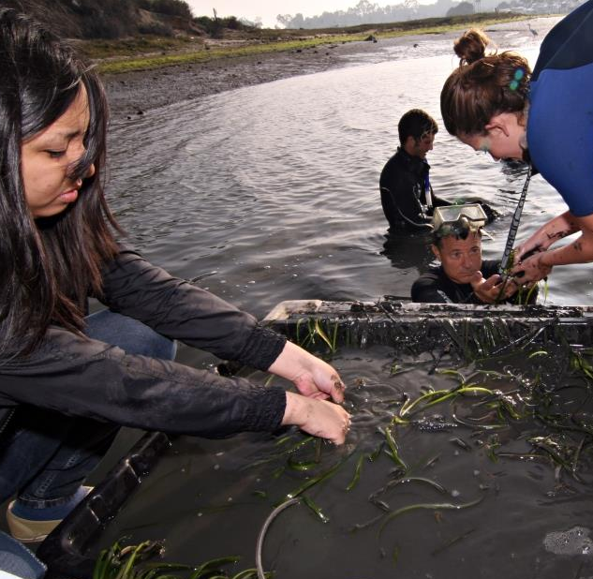
National Fish Habitat Action Plan
Mission: to protect, restore and enhance the nation’s fish and aquatic communities through partnerships that foster fish habitat conservation and improve the quality of life for the American people.
This mission will be achieved by:
Supporting existing fish habitat partnerships and fostering new efforts
Mobilizing and focusing national and local support for achieving fish habitat conservation goals
Setting national and regional fish habitat conservation goals
Measuring and communicating the status and needs of fish habitats
Providing national leadership and coordination to conserve fish habitats
Notes:
Accomplishment since 2006:
Approved 18 Fish Habitat Partnerships covering all 50 states and the District of Columbia.
Conducted 341 conservation projects in 46 states.
Completed the first ever national assessment of fish habitat.
Completed an agreement between the US Departments of the Interior, Agriculture, and Commerce to support the NFHP.
Highlighted 60 key projects through the “10 Waters to Watch” program.
Created a map and data web tool at ecosystems.usgs.gov/fishhabitat

Slide 10
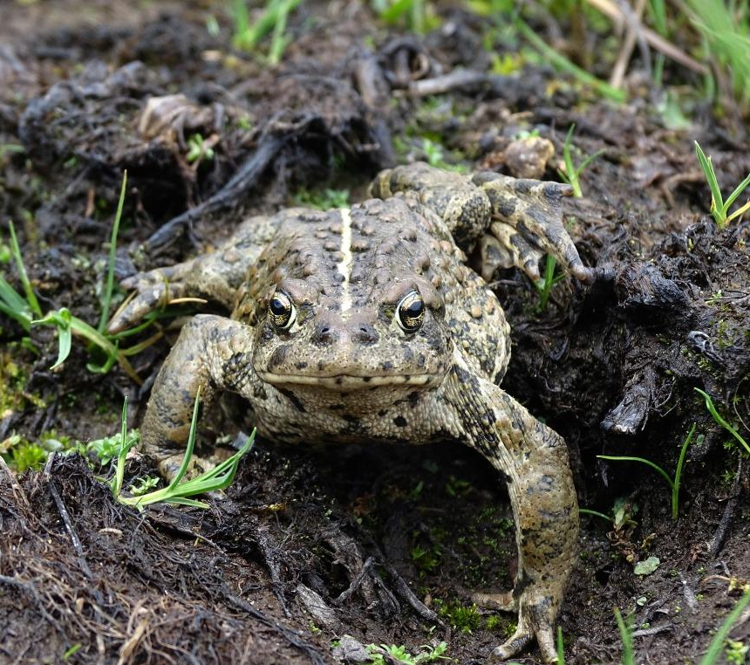
State wildlife Action Plans
State Wildlife Action Plans serve as the blueprints for conserving our nation's fish and wildlife and preventing endangered species.
over 12,000 species in greatest conservation need
plans developed in collaboration with leading scientists, conservationists, private landowners and other citizens.
~$63 million appropriated annually through the State and Tribal Wildlife Grants to the 56 states, territories and the District of Columbia to implement the plans
Notes:
A survey by a natural resources economist estimated that $1.3 billion is needed annually to implement the plans. The Blue Ribbon Panel on Sustaining America's Diverse Fish and Wildlife Resources reviewed funding options and recommended that existing royalties and fees from the development of energy and mineral resources on federal lands and water be invested in the implementation of State Wildlife Action Plans. The Alliance for America's Fish and Wildlife is leading the campaign to secure increased and dedicated funding by supporting passage of the Recovering America's Wildlife Act.

Slide 11
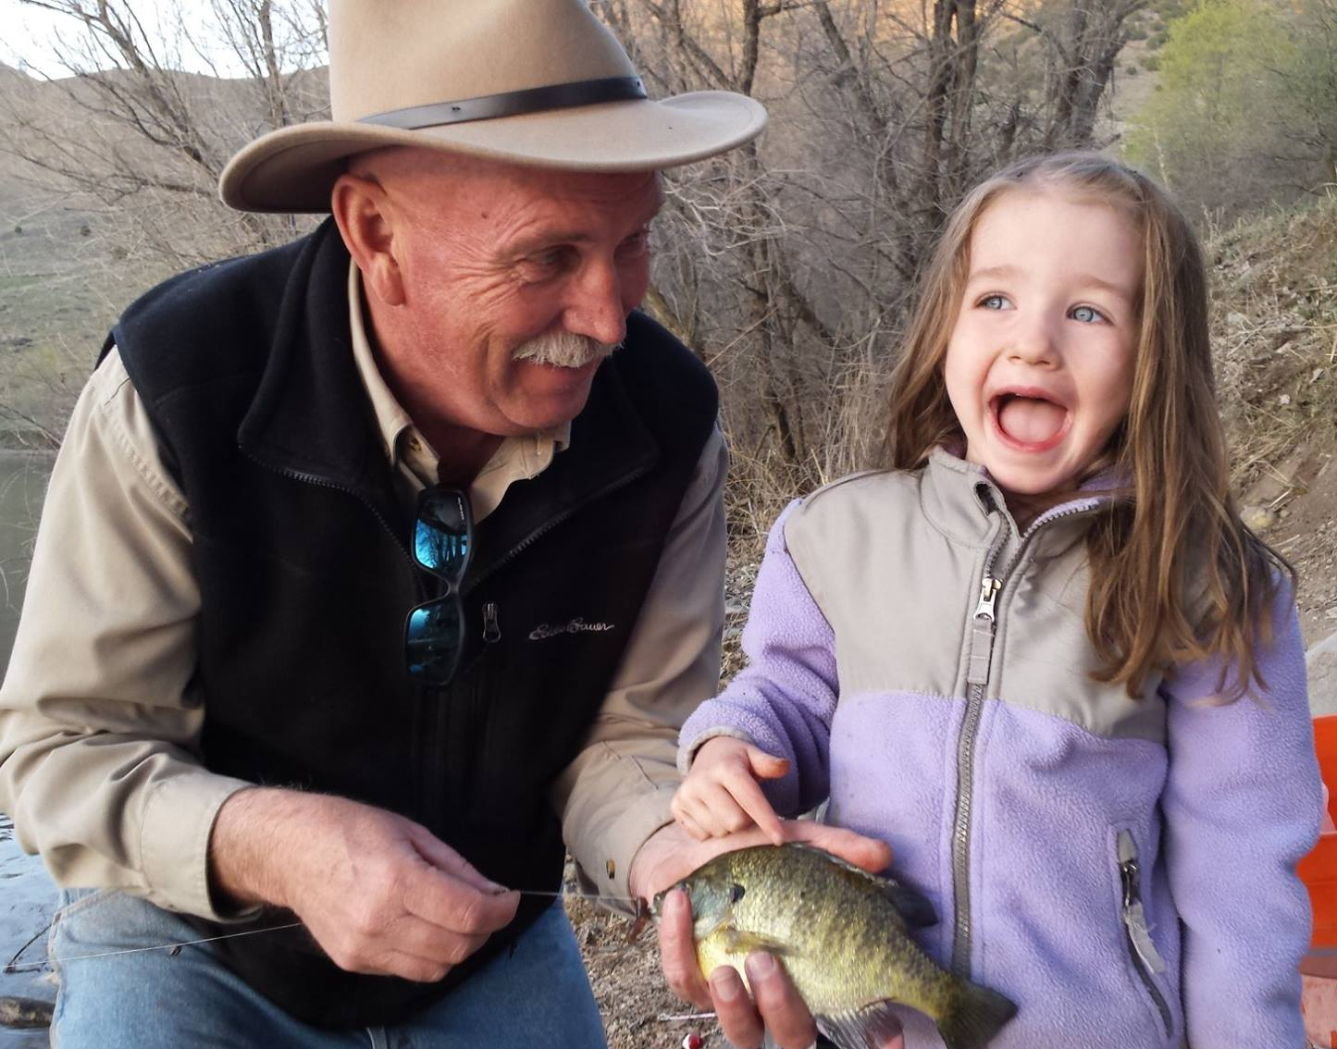
Coordinated conservation initiatives
Coordinate, collaboration & educate
Member Issues & Species-based Interests
North American Conservation Education Strategy
Agency/Industry Partnership
Multistate Conservation Grant Program
Bird Conservation Initiatives &
Joint Ventures
Partners in Amphibian and
Reptile Conservation
Notes:
Goal: coordinate and facilitate fish and wildlife conservation initiatives among state, provincial, territorial, federal agencies and other partners, enabling conservation delivery on a landscape scale
Initiatives: develop and strengthen conservation & science-oriented partnerships; build international partnerships; strengthen business and industry relationships; support national outreach and education initiatives; enhance relevancy of state conservation initiatives

Slide 12
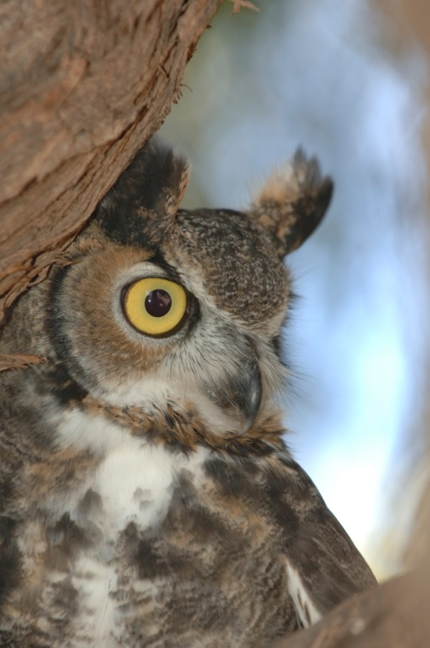
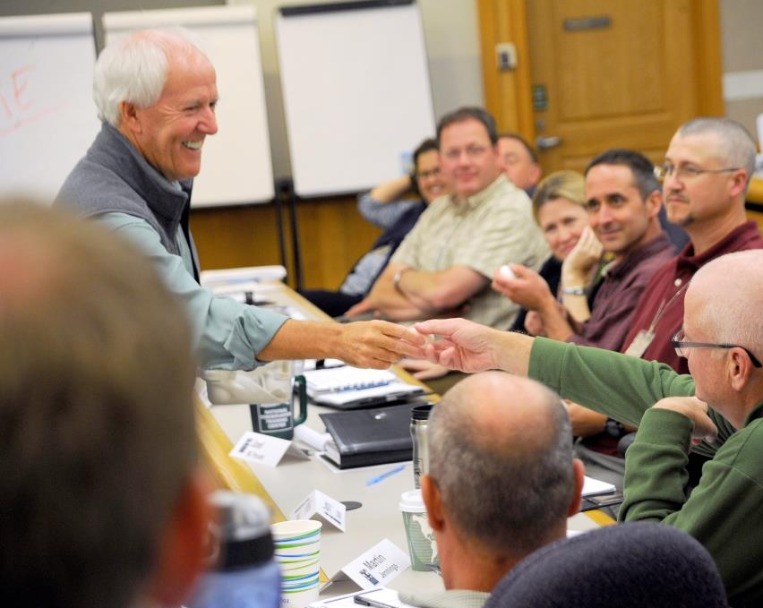
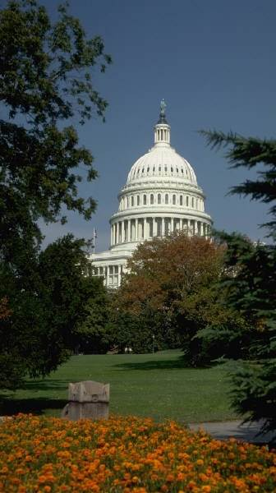
Member support
Notes:
Goal: Support and facilitate education, participation, communication and leadership capacity for and among state, provincial and territorial agencies to enhance fish and wildlife conservation
Initiatives: raise member awareness of AFWA’s Value to state, provincial and territorial fish and wildlife agencies and conservation; raise awareness of the prominent issues and the role of fish and wildlife agencies; provide professional development; AFWA organizational effectiveness and operational management

Slide 13
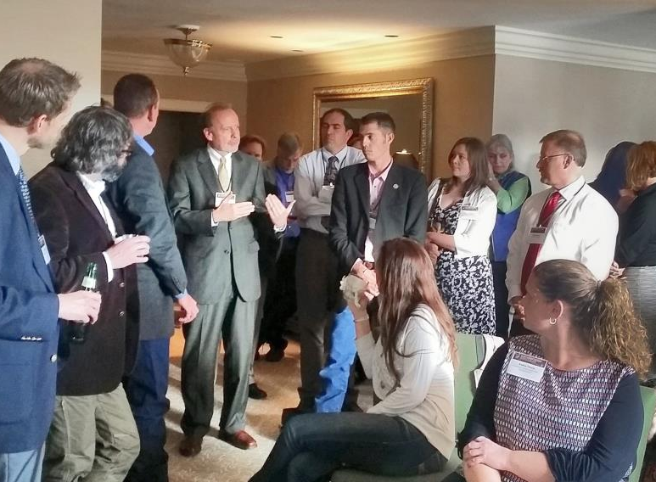
Conservation leadership
Training a new generation of leaders in fish and wildlife conservation…
National Conservation Leadership Institute
Delivers select leadership training
Management Assistance Team
Offers leadership development toolbox
Conducts workshops and online courses
Provides agencies with on-site consulting

Slide 14
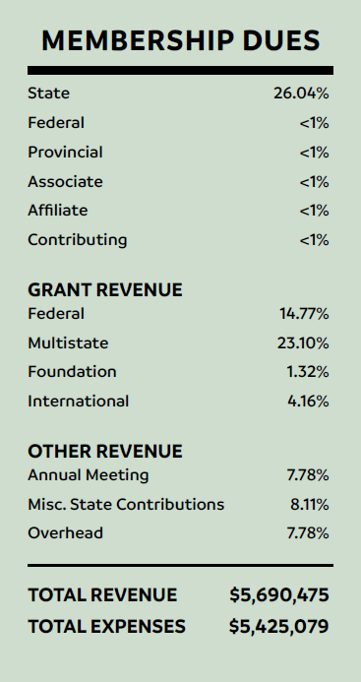
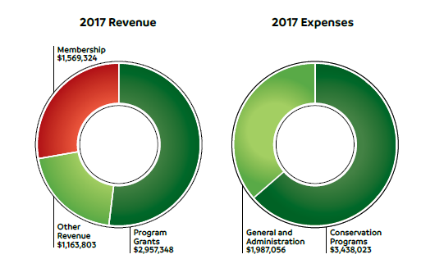
finances
Notes:
The funds entrusted to the Association enable us to provide coordinated services; support national and international programs, projects and coalitions; promote wildlife-associated recreation; and help members continue to address the most pressing conservation challenges of the day.

Slide 15
Collaboration
Afwa
core
values
Community
Excellence
Respect
Responsiveness
Notes:
Equally important, but never articulated until recently, are the values that define our organizational culture through which staff achieve their goals. In 2017 the Association stood up a team to develop the AFWA Core Values.

Slide 16
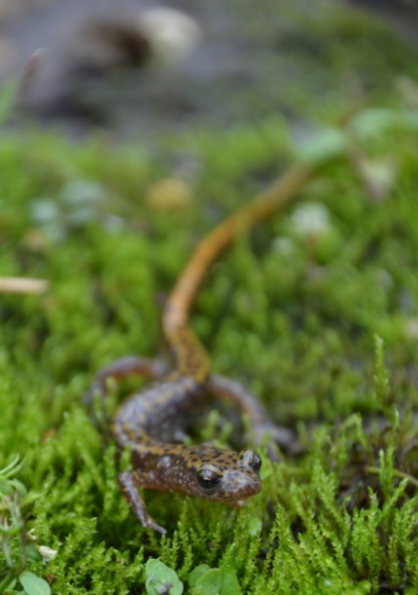
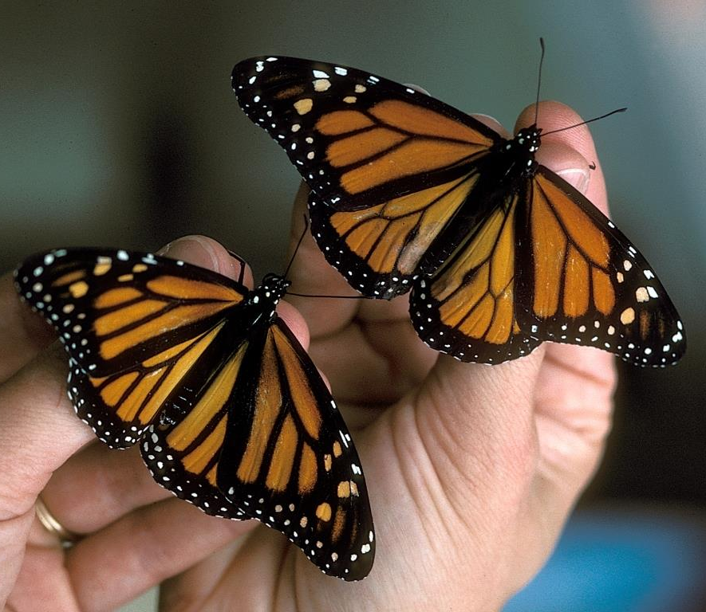
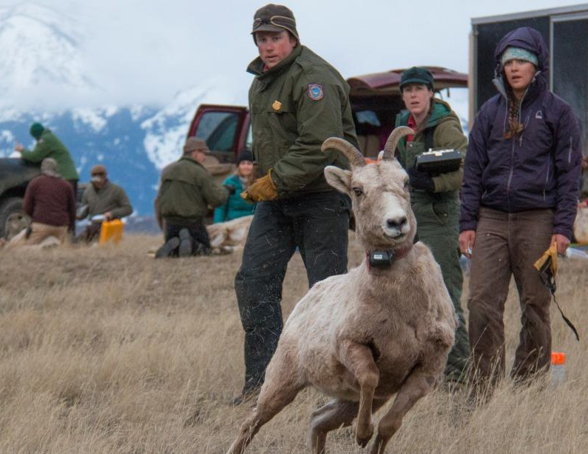
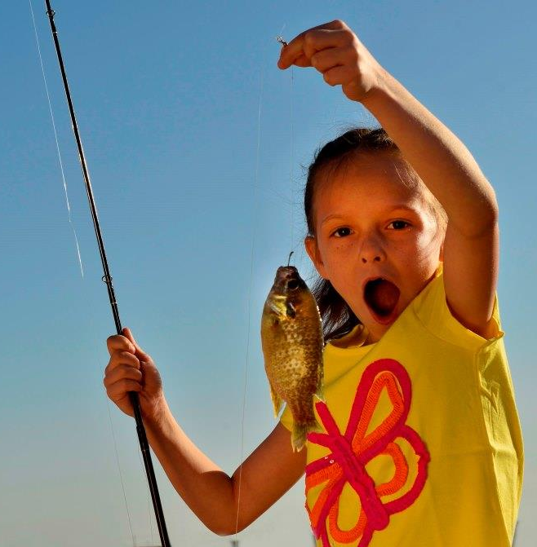
Sustainable fish and wildlife populations and habitat management in trust for and supported by the public.
Our vision
Notes:
Healthy fish and wildlife resources throughout North America managed by effective, well-funded fish and wildlife agencies supported by informed and involved citizens.

